Slide 1

User Interface Design
Buttons, Text, and Images

Slide 2
Learning Objectives
Understand the fundamentals of UI design in Unity.
Learn how to create and customize buttons, text, and images.
Gain hands-on experience in designing a user-friendly interface.
Notes:
Online tutorial for this lesson:
https://www.youtube.com/watch?v=b0O2CRSdiOA&list=PLX2vGYjWbI0S-LEFR59E2B347w2HbjiJv
https://docs.unity3d.com/Manual/AnimationOverview.html

Slide 3
UI Design Principles Recap
Summary of UI Design Principles:
Simplicity (clarity): Simplify the interface for ease of use and understanding. Remove unnecessary elements and focus on basic, intuitive design.
Consistency: Maintain consistency in the display and behavior of interface elements. This aids users in predicting and using the interface easily.
Visibility: Ensure essential elements are displayed prominently and are easy to find. This helps users understand how to use and interact with the interface.
Notes:
• Brief recap of fundamental animation scripting concepts covered in previous sessions.
• Reminder of the importance of scripting for dynamic and controlled movement.

Slide 4
UI Design Principles Recap
Summary of UI Design Principles:
Hierarchy: Arrange elements by importance and their relationships. Create a structured layout that is easy to comprehend.
Feedback: Provide immediate feedback when users interact with the interface. This helps them understand their actions and feel in control.
Accessibility: Design the interface so that all users, including those with disabilities, can use it easily and conveniently.
Flexibility: Allow users to customize the interface to create a personalized experience.

Slide 5
UI Design Principles Recap
Requirements for interface design:
Immediate Response: When users interact with an interface, immediate feedback confirms that their action has been registered. For instance, a button press changing color to show it has been clicked.
Error Handling: Clear feedback is essential when users make mistakes. Providing helpful error messages or visual cues guides them on correcting the error.
Progress Indication: In interfaces with time-consuming actions (like downloads or form submissions), progress bars or spinners give users a sense of how long they need to wait.

Slide 6
UI Design Principles Recap
Requirements for interface design:
Confirmation: When users perform significant actions (such as making a purchase or deleting an item), a confirmation message helps prevent accidental actions.
User Testing: Gathering feedback directly from users through surveys, interviews, or testing sessions is crucial. This helps designers understand user needs and preferences better.
User feedback is not only about visual or auditory responses from the interface; it's also about the broader process of understanding and accommodating user preferences, expectations, and experiences throughout the design journey. It's an iterative process that often leads to refining and improving UI design.

Slide 7
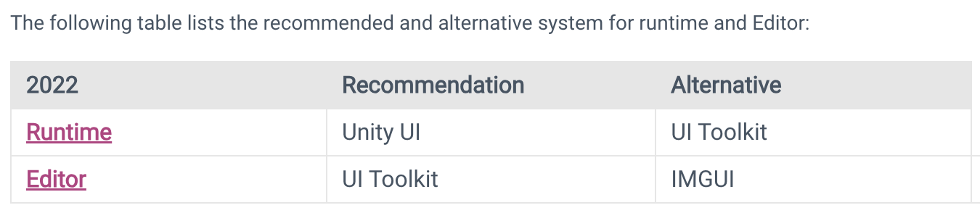
Unity User Interface Systems
Unity provides three UI systems that you can use to create user interfaces (UI) for the Unity Editor and applications made in the Unity Editor:
UI Toolkit
The Unity UI package (uGUI)
IMGUI
8: Unity Technologies, Unity Manual, 2023
Notes:
https://docs.unity3d.com/Manual/UIToolkits.html
https://docs.unity3d.com/Manual/UI-system-compare.html

Slide 8
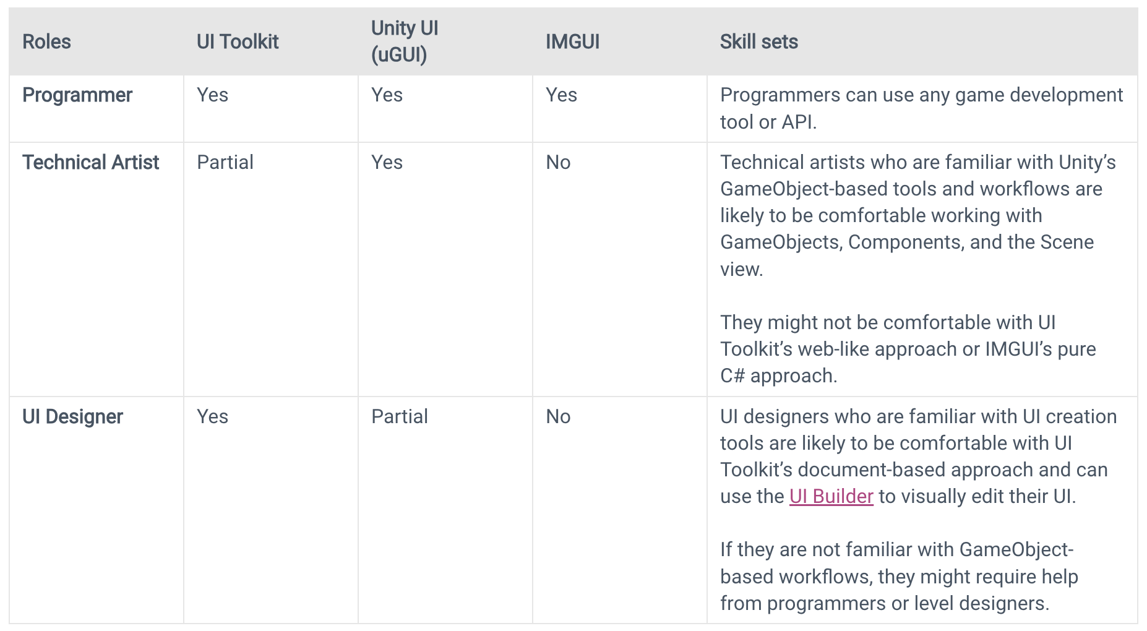
Unity User Interface Systems
Comparison of UI systems in Unity
8: Unity Technologies, Unity Manual, 2023

Slide 9
Unity UI (uGUI)
Unity UI is a set of tools for developing user interfaces for games and applications. It is a GameObject-based UI system that uses Components and the Game View to arrange, position, and style user interfaces. ​ You cannot use Unity UI to create or change user interfaces in the Unity Editor.
In Unity UI, you use components and the Game view to arrange, position, and style the user interface. It supports advanced rendering and text features.
8: Unity Technologies, Unity Manual, 2023
Notes:
https://docs.unity3d.com/Packages/com.unity.ugui@1.0/manual/index.html

Slide 10
Unity UI Components Overview
uGUI components assist in writing games and applications:
Canvas/Panel: Serves as a container for other UI elements, helping in organization and layout.
Text: Displays text content and can be styled for various fonts, sizes, colors, and alignments.
Image: Renders 2D images or sprites, allowing for the display of icons, backgrounds, or any visual content.
Button: Enables user interaction; responds to clicks or taps, triggering actions in the application.
Input Field: Allows users to input text, numbers, or passwords. Useful for forms, login screens, or search bars.

Slide 11
Unity UI Components Overview
Slider: Offers a draggable handle on a track, allowing users to select a value within a range.
Toggle: Represents an on/off or true/false state, often used in settings or checkboxes.
Dropdown: Displays a list of options when clicked, allowing users to choose from a selection.
Scroll View: Handles scrollable content, useful for long lists or content that doesn't fit in a fixed area.
Layout Groups: Grouping elements together for automatic arrangement, including grid, horizontal, or vertical layouts.
These components, combined and customized using Unity's interface or scripting (C#), create interactive and visually appealing user interfaces in Unity. They offer a range of functionalities to build various UI elements in games or applications.

Slide 12
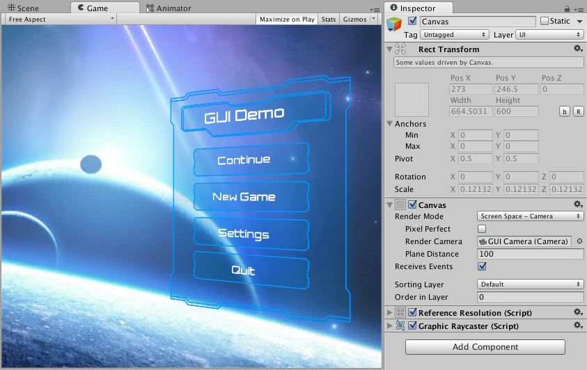
Canvas
The Canvas is the area that all UI elements should be inside. The Canvas is a Game Object with a Canvas component on it, and all UI elements must be children of such a Canvas.
Creating a new UI element, such as an Image using the menu GameObject > UI > Image, automatically creates a Canvas, if there isn't already a Canvas in the scene. The UI element is created as a child to this Canvas.

Slide 13
Designing Buttons
Unity's UI system provides a Button component that allows you to create interactive elements easily. Buttons can be created from Images or Text and respond to user interactions like clicks or taps.
Button States: Buttons have different states like Normal, Highlighted, Pressed, and Disabled. Each state can have its appearance, allowing you to create visual feedback for user interactions.
Customization Options: Unity offers various customization options for buttons, including:
Images: You can use custom images or sprites to create unique button designs.
Color Transitions: Change button colors or transparency when states change.
Text Formatting: Customize text within the button using different fonts, sizes, colors, and alignments.
Notes:
https://docs.unity3d.com/ScriptReference/UIElements.Button.html

Slide 14
Designing Buttons
Animations and Interactivity: Buttons can be animated using Unity's animation system or event triggers. This can create engaging effects, such as scaling or color changes, when the button is interacted with.
Button Click Events: Unity allows you to assign functions or methods to buttons. These functions can be triggered when the button is clicked, allowing you to define specific actions or behaviors in response to user input.
Scripting Custom Behaviors: Through scripting, you can create custom button behaviors, enabling functionalities like loading scenes, triggering character actions, or toggling UI elements.
Optimization: Consider optimizing button assets by using sprite atlases or sprite sheets to minimize draw calls and improve performance, especially when using multiple buttons or complex UI.
Notes:
https://docs.unity3d.com/ScriptReference/UIElements.Button.html

Slide 15
Designing Buttons – Button states
Button states and state transitions are essential aspects of designing interactive buttons within Unity's UI system. Here's an overview:
1. Button States:
Normal: The default appearance of the button when not interacted with.
Highlighted: When the mouse hovers over or the finger touches the button, providing visual feedback to the user.
Pressed: The appearance when the button is clicked or tapped, indicating the action has been initiated.
Disabled: The appearance when the button is inactive or not interactable.

Slide 16
Designing Buttons – Button states
2. State Transitions:
Transition Types: Unity allows you to define how the button transitions between states.
Color Tint: Changing button colors or applying tints for different states.
Sprite Swapping: Swapping button images or sprites based on states.
Animations: Applying animations or visual effects during state transitions, enhancing user feedback and engagement.
Interactivity Changes: Altering the interactability of the button in different states (e.g., disabling a button when it's already pressed).

Slide 17
Designing Buttons – Button states
3. Visual Feedback:
Providing visual cues or feedback helps users understand the button's functionality.
Consistent and clear state changes improve user experience and interface intuitiveness.
4. State Transition Properties:
Duration: Adjusting the speed of the transition effect between states.
Ease Type: Defining how smoothly the transition occurs (e.g., linear, ease-in, ease-out).
5. Unity's UI Tools:
Unity's UI system offers an interface for managing and configuring these states and their transitions visually through the Inspector.

Slide 18
Designing Buttons – Button Animation
Unity's Animation System for Buttons:
Animator Controller: Enables setting up different animation transitions based on button states.
Animation Triggers: Mechanisms to control animations based on button interactions.
State Transitions: Smooth transitions between different button states for a polished user experience
Visual Feedback: Animations offer visual changes in response to user interactions, enhancing feedback and making buttons more intuitive.

Slide 19
Designing Buttons – Button Animation
Customizing Button Animations:
Animator Component: Offers tools to create and control animations for buttons.
Animation Clips: Allows for the creation of specific animations tied to button states.
In Unity, animating buttons involves creating visual feedback and state changes that respond to user interaction. It's about making buttons feel responsive, intuitive, and visually appealing, enhancing the overall user experience in applications or games.

Slide 20
Designing Buttons – Scripted Interactivity
Scripted interactivity for buttons in Unity involves using C# scripts to control and manipulate button behavior beyond default interactions
C# Scripts: Allow for scripted control of button animations based on specific conditions or game logic.
Event Triggers: Using scripts to trigger animations in response to button events or interactions.

Slide 21
Typography in UI
Typography principles in UI design within Unity involve the strategic use of fonts, text sizes, alignment, and hierarchy to ensure clear communication and visual appeal.
It focuses on selecting appropriate fonts, maintaining readability, establishing a consistent style, and integrating typography seamlessly with other UI elements to create an engaging and user-friendly interface.

Slide 22
Typography in UI
Font Selection:
Typefaces: Choose typefaces that complement the overall design aesthetic and suit the application's tone. Consider factors like readability, style, and appropriateness for the target audience.
Font Families: Use a hierarchy of font styles (such as regular, bold, italic) to create visual contrast and emphasize important information.
Readability:
Text Size: Ensure legibility by choosing appropriate text sizes for different UI elements. Titles, subtitles, and body text should be clearly distinguishable in size.
Line Spacing and Kerning: Adjust line spacing and kerning to optimize readability. Avoid overcrowding text elements.
Contrast: Maintain a suitable contrast between text and background colors to enhance readability, especially for users with varying screen resolutions or visual impairments.

Slide 23
Typography in UI
Consistency:
Visual Consistency: Maintain a consistent typography style throughout the UI for coherence. Use a limited set of fonts and styles to avoid visual clutter.
Hierarchy: Establish a clear hierarchy through font size, weight, and style to guide users' attention to the most important information.
Alignment and Layout:
Text Alignment: Ensure proper alignment to maintain visual order and readability. Align text elements based on the design's grid or structure.
Whitespace: Use whitespace effectively to improve readability and create a balanced layout.

Slide 24
Typography in UI
UI Elements Integration:
Integration with Other Elements: Harmonize typography with other UI elements, such as buttons, images, and backgrounds, to create a cohesive design.
Responsive Typography: Ensure text elements adapt well across different screen sizes and resolutions to maintain readability and aesthetics.
Accessibility:
Accessibility Considerations: Design text elements with accessibility in mind, ensuring readability for users with visual impairments. Use appropriate font sizes and contrast ratios.

Slide 25
Adding and Styling Text
In Unity, adding and styling text can be achieved using the Text Component. You can attach the Text Component to objects in the Scene and customize the displayed text. This involves selecting fonts, setting sizes, colors, and aligning the text. Utilizing these attributes helps create text that aligns with the user interface design, ensuring clarity and readability.

Slide 26
Example of using Text Component
Create a simple UI displaying the player's score:
Create Canvas: First, create a canvas in your scene (if you haven't already). Right-click in the Hierarchy panel, go to UI, and select "Canvas".
Add Text Element: Right-click within the Canvas in the Hierarchy panel, go to UI, and select "Text" to create a new Text element. This will automatically create a UI Text object nested under the Canvas.
Customize Text: With the Text object selected, you can edit its properties in the Inspector panel. You can set the font, size, color, alignment, and other text-related attributes.

Slide 27
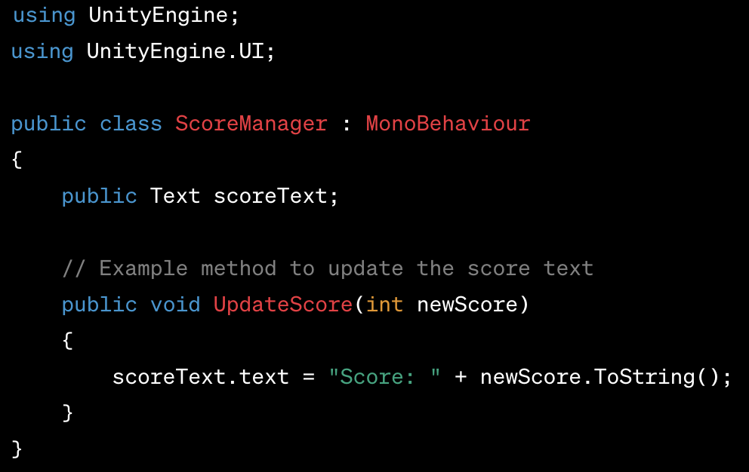
Example of using Text Component
4. Control Text via Script: You can create a C# script that accesses the Text component to update its content dynamically. For instance, you might have a script called "ScoreManager" that manages the player's score. Within this script, you can reference the Text component, access its ‘text’ property, and update it accordingly:

Slide 28
Example of using Text Component
Attach Script and Text Component: Attach the ‘ScoreManager’ script to a GameObject in your scene. Drag the Text component you created earlier into the ‘scoreText’ field in the Inspector of the attached script.
Invoke Script Methods: You can then call the ‘UpdateScore’ method from other scripts or events in your game whenever the player's score changes. For example, when the player collects points, the ‘UpdateScore’ method is called with the new score as an argument.
This setup will enable the Text component to dynamically display the player's score in the UI. Adjustments to the text appearance or content can be managed both in the Editor and via script, offering flexibility in UI design.

Slide 29
Incorporating Images
Incorporating images into Unity involves using the Image component within the UI system.
Canvas Creation: Begin by creating a canvas. Right-click in the Hierarchy panel, select UI, and then choose "Canvas".
Adding an Image: To include an image, right-click within the Canvas in the Hierarchy panel, go to UI, and select "Image". This creates an Image GameObject as a child of the Canvas.
Image Settings: Select the Image GameObject. In the Inspector panel, you can modify its properties. This includes choosing the source image by dragging a sprite or texture into the 'Source Image' field. You can also adjust its dimensions, position, and other visual attributes.

Slide 30
Incorporating Images
Using Scripts: If you need to update the image dynamically, you can use scripts. For example, you might have a script that changes the displayed image based on in-game events or player actions.
Sprite Renderer: If working with images in a 3D environment rather than UI, Unity uses the Sprite Renderer component to display 2D images. You'd assign a sprite to the Sprite Renderer in this case.
This allows you to easily incorporate images into your Unity project, whether for UI elements like icons or buttons, or for 2D game assets displayed in the game world.

Slide 31
Layout and Alignment
Layout and alignment in Unity are crucial for organizing and positioning UI elements effectively.
Canvas and UI Elements: Unity's Canvas acts as a container for UI elements. You can place various UI components like text, images, buttons, etc., on this Canvas.
Layout Groups: Unity offers Layout Group components (such as Grid Layout Group, Horizontal Layout Group, Vertical Layout Group) that automatically arrange UI elements. These groups simplify the layout process, ensuring elements conform to predefined patterns.
Anchors and Rect Transform: Anchors define how UI elements adapt to screen sizes. The Rect Transform component allows controlling an element's position, rotation, and scale in relation to its parent or the Canvas.

Slide 32
Layout and Alignment
Alignment Tools: Unity provides tools for precise alignment, including snapping, guides, and grids. These aid in aligning and positioning elements accurately within the Canvas.
Responsive Design: Unity allows for creating responsive designs using anchors, ensuring UI elements adjust appropriately across different screen sizes and resolutions.
Understanding layout and alignment principles is essential for creating visually appealing and user-friendly interfaces in Unity, ensuring elements are properly positioned and organized regardless of the platform or device.

Slide 33
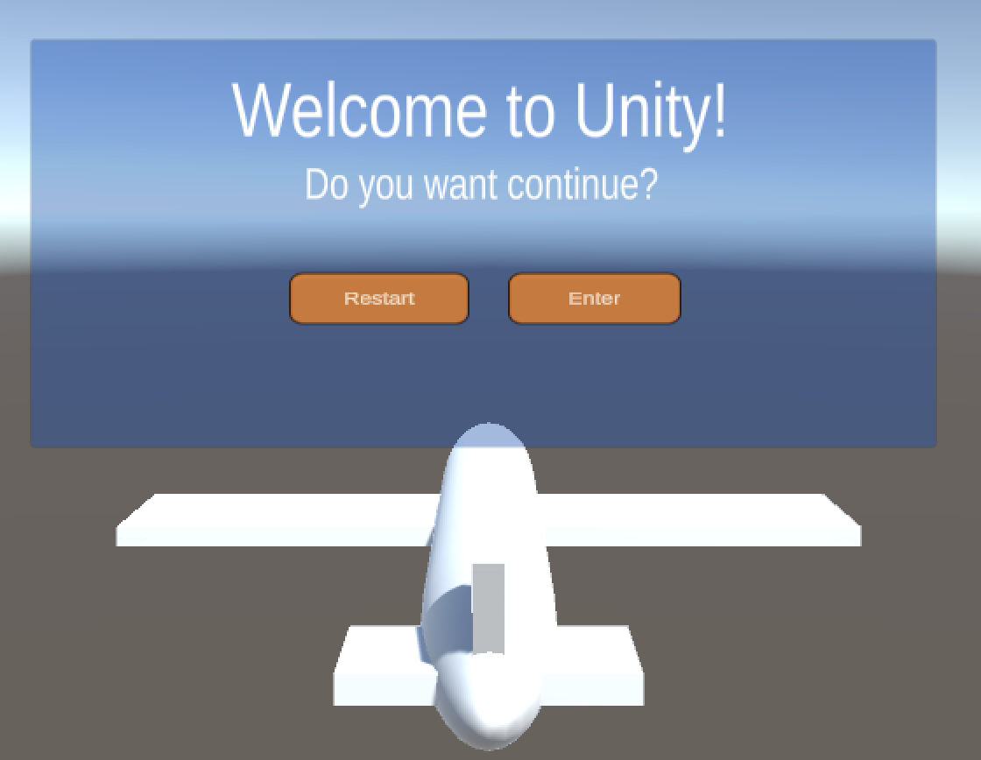
Coding Exercise: UI Design Elements
Design a pop-up menu with a title, message, and two buttons: Continue and Restart. Utilize Canvas, panel, Text Mesh Pro, and Button Mesh Pro. Adjust the color and visuals of the popup to fit your own design aesthetic.
Integrate a C# script to display the Popup only when the airplane has taken off and collided with the Enter Wall as per the previous exercise. Implement loading the content of title, message, button.text from the code.
Write C# scripts for the Restart and Enter buttons to reload the scene or transition to the next scene.
Notes:
Students need to follow the next slide's instructions to practice with Unity.
Practice Resources sharing:
https://drive.google.com/drive/folders/1eXu20cX1o-5uMFuSeHGxRS5AkhDZJTOP?usp=sharing
For lecturer: open file in: ./LO.3-Animations-and-Physics/Lecturer-Guide/3.3_User-Interface-Design-Buttons-Text-and-Images.mp4
And user Assets file in ./LO.3-Animations-and-Physics/Lecturer-Guide/Assets/3.3_User-Interface-Design-Buttons-Text-and-Images/*
To create the final project.

Slide 34
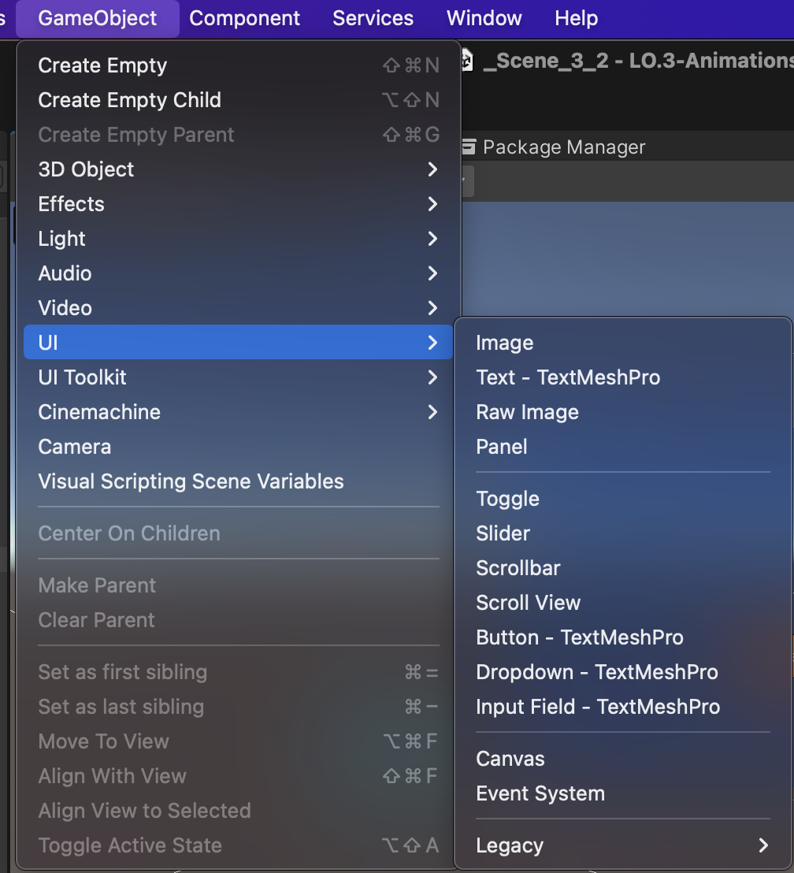
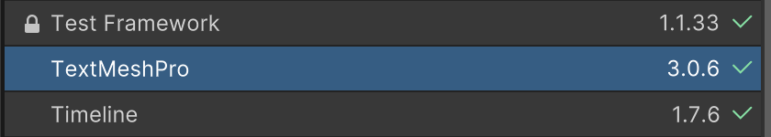
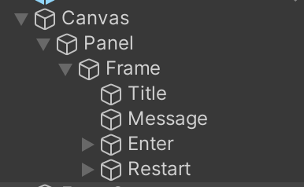
Coding Exercise 1
Import TextMeshPro. Use TextMeshPro instead of legacy text/button for better design..
Add Canvas, Panel, Empty Object, Title (TMP_Text), Message (TMP_Text), Enter button, Restart button in the order and following below structure:

Slide 35
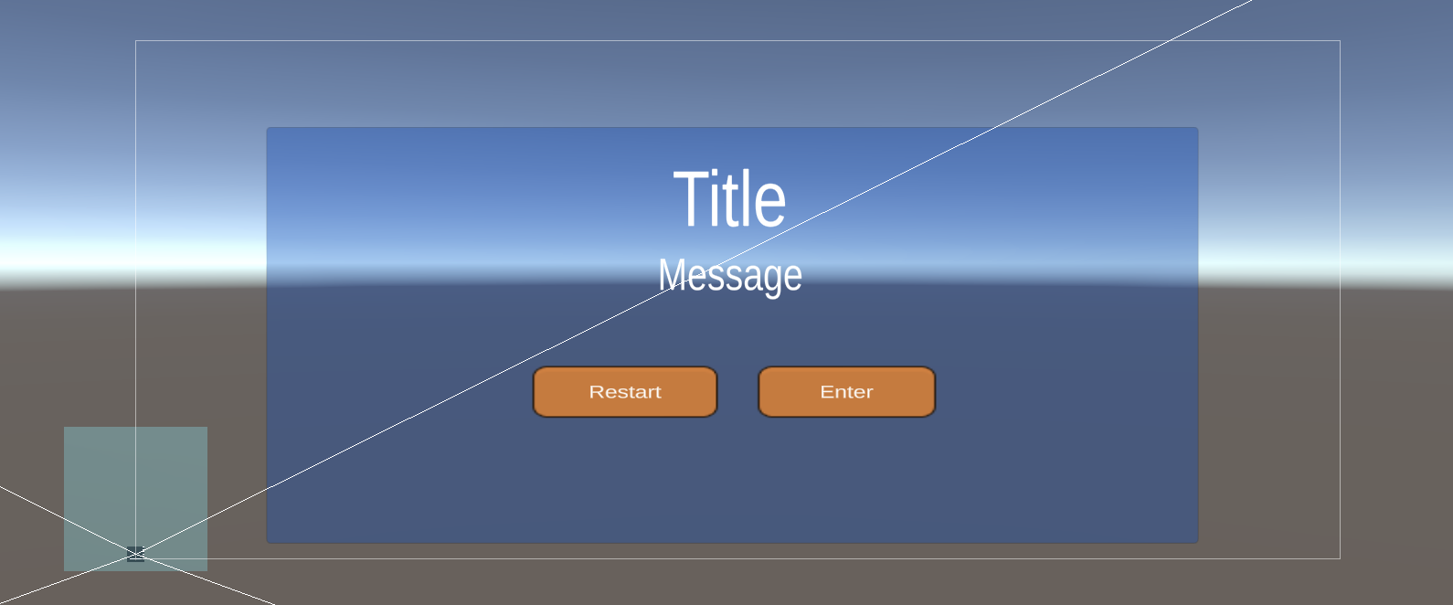
Coding Exercise 1
Design your panel and preview it.

Slide 36
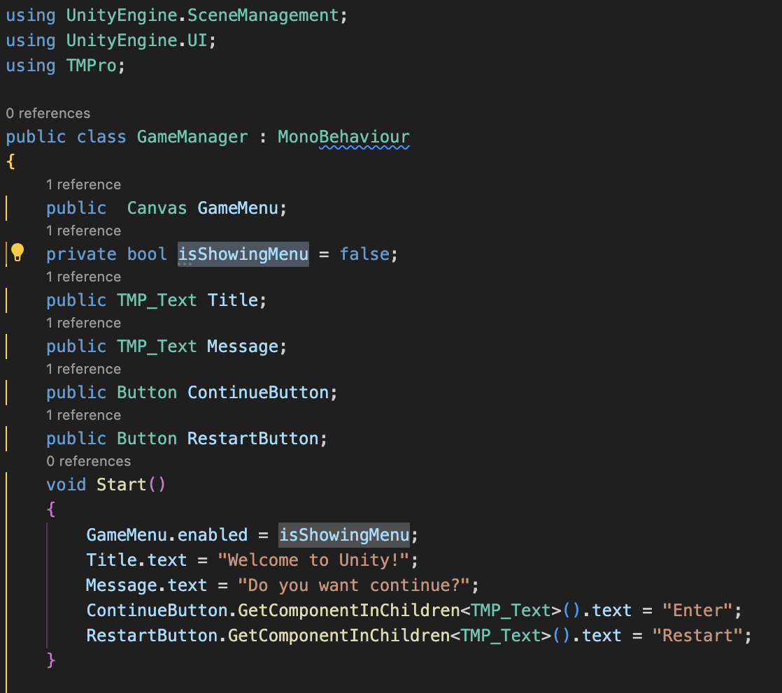
Coding Exercise 2
Add new C# script ‘GameManager.cs’.
Disable Canvas by default
Dynamic content

Slide 37
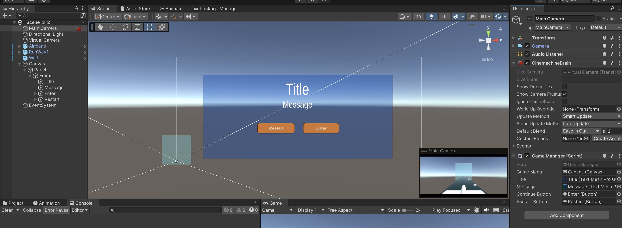
Coding Exercise 2
GameManger.cs needs to be started by default, so we should add it to the Main Camera component.
Reference UI components to the script by drag and drop UI component to the Script parameter.

Slide 38
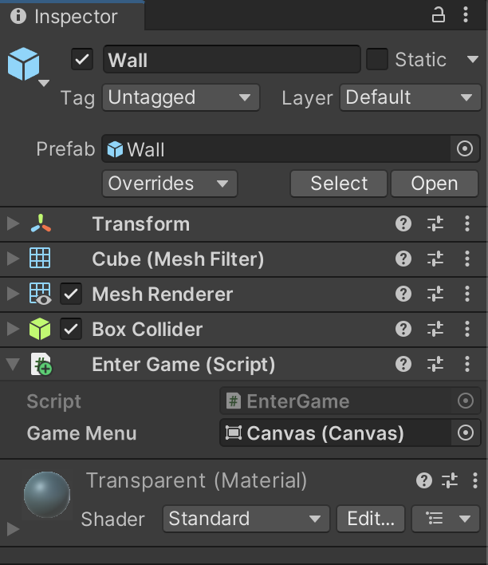
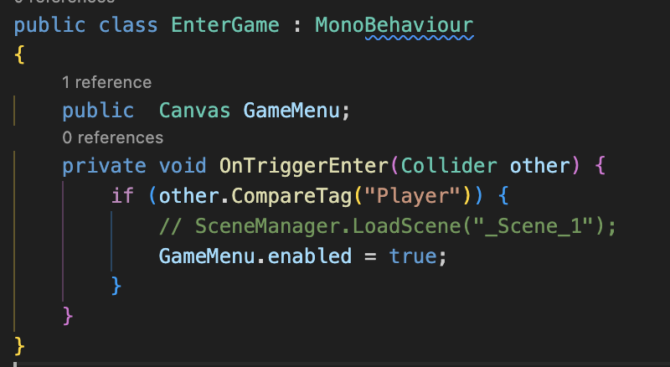
Coding Exercise 2
Modify the code of the trigger (EnterGame.cs) to open a popup immediately when the airplane collides with the wall instead of transitioning to another scene
Create a reference for the trigger to enable the canvas in the scene.

Slide 39
Coding Exercise 2
Now you can start the game to test the display of GameMenu.

Slide 40
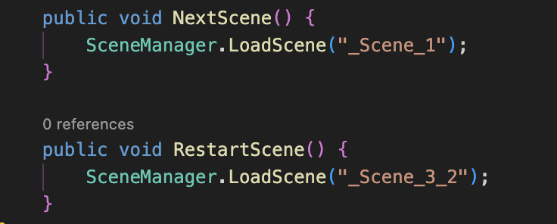
Coding Exercise 3
Add 2 function to GameManager.cs to control the button.

Slide 41
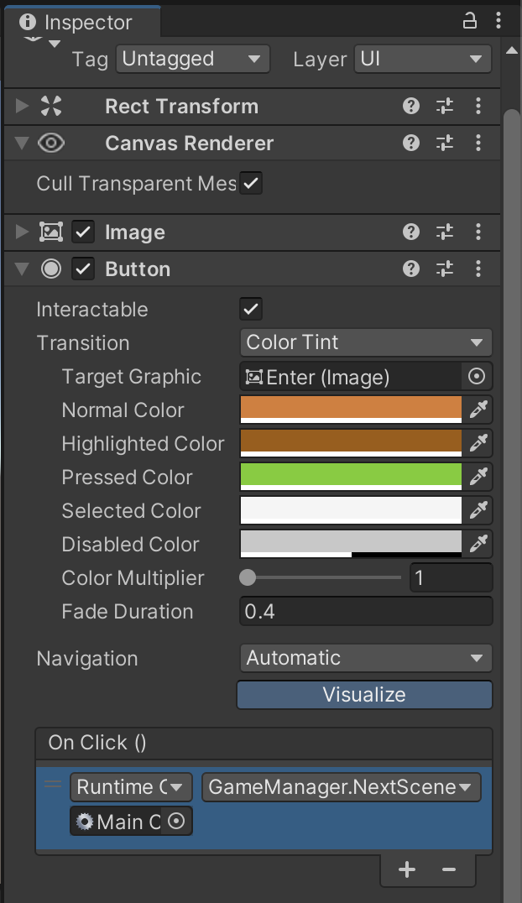
Coding Exercise 3
Create a reference for the 'Continue' button by dragging and dropping the 'Main Camera' into the 'onClick()' GameObject section and select the function 'NextScene()'.
Do the same for the Restart button.

Slide 42
Conclusion and Next Steps
Covered essential Unity UI components: Canvas, Image, Text, and Button, showcasing their role in UI design.
Explored detailed button design and customization methods within Unity, including various button states and interactions.
Introduced typography principles and their application in UI design, emphasizing effective text placement and readability.
Explored techniques for adding, styling, and displaying information using Text components in Unity.
Delved into the incorporation and customization of images, focusing on their visual appeal and branding within UI design.
Discussed layout and alignment principles to create visually balanced and organized interfaces in Unity.

